Slide 1
Concurrent Operation of Wireless Power Transfer Based Contactless Slip Ring and Motor Drive System with a Single Converter
Enes Ayaz
M.Sc. Thesis Defense
Middle East Technical University (METU), Department of Electrical and Electronics Engineering Ankara, TURKEY
September 2022
Notes:
Hello dear committee and colleagues.
I am enes ayaz, today I will defense my thesis entitled
Concurrent operation of Wireless power transfer based contactless slip ring an motor drive system with a single converter.

Slide 2
Outline
Research Motivation
Operating Principles of Wireless Power Transfer Systems
Theory of the Proposed CSR System
Implementation of the Proposed Method with DC Motor Drives
Implementation of the Proposed Method with AC Motor Drives
Implementation of the Proposed Method for Field Excitation of SM
Conclusion
Notes:
Here is my outline.
Fisrtly, I give the main motivation behind the study.
Secondly, we talk about the basics of wireless power transfer sytem.
Then, we discussed the theoty of the proposed system .
After that, following three parts are related to implementation of the proposed system to different applications and motor drives and I wille present experimental results.
Finaly, we discussed the litereatures and talk about main contribution of the our system, and give possible future works.

Slide 3
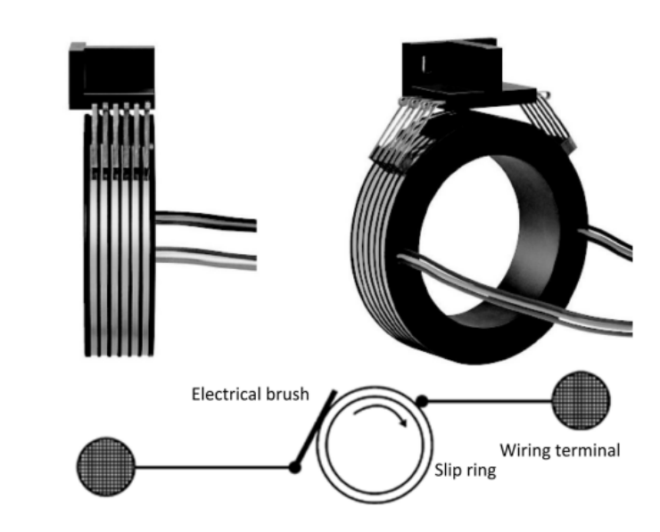
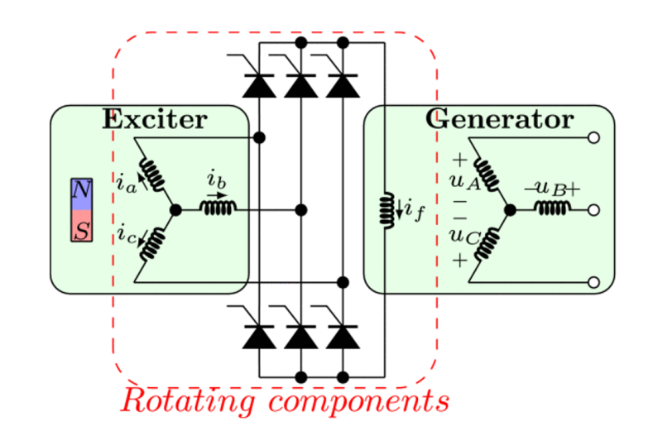
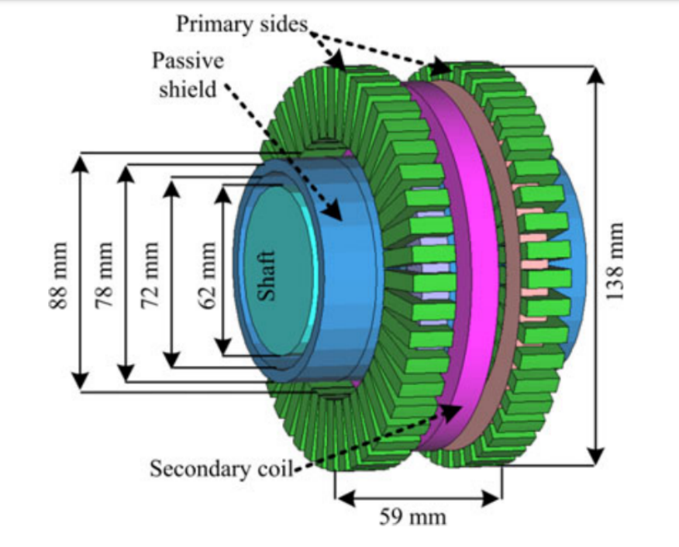
Power Transfer to Rotating Frames
Slip Rings
Brushless Exciter
Contactless
Slip Rings
Notes:
Okey here we go,
Power transfer to rotating frames is required in many industrial applications.
Rotating sensors
Spindle motors
Radars
Field excitations
There are several methods of it.
First one is Slip Rings, or mechanical slip rings.
They are made up of conductor rings and carbon brushes rubbed with these rings.
Second one is Brushless exciters, which is actually a PM synchronous generator with rectified output.
Third one is contactless slip rings based on Wireless power transfer. It can be counted as an air-core contactless transformer.

Slide 4
Comparison of the Conventional Solutions
 | Slip Rings | Brushless Exciters | Contactless Slip Rings
Reliability | - | + | +
Maintenance | - | + | +
Simplicity | + | + | -
Speed Independency | + | - | +
Cost Effectivity | + | + | -
Efficiency | + | - | +
Notes:
Each of them have some advantages and disadvantages.
Slip rings are simple, cost effective and efficient. However, they are unreliable and require regular mainantance due to the physical wear of continuous friction.
Brsuhless exciters are reliable, but their power transfer capability changes with the rotation speed. Since it is actually a generator, increasing speed also increases the voltage. Therefore, it is suitable to use in constant speed operation.
Contactless slip rings both reliable and give speed independent output voltage. However, they are complex and costly.

Slide 5
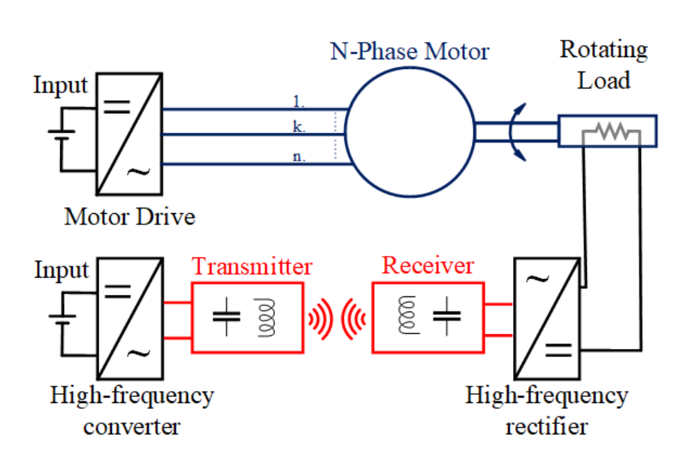
Conventional Inductive Power Transfer Based Contactless Slip Ring
Two converters:
To drive the motor
To excite the Tx coil
Motor → attenuated in motor current
The motor drive → generating low and high frequencies
Motor → used to drive
The WPT converter → generating high frequency
The WPT system →behaves like band-pass filter
Notes:
Our main focus is contactless slip rings.
Here we have a representation of conventional contactless slip rings.
Common trait of these contactless slip rings applications, we have motor drive system to rotate the load.
AS WPT systems used in CSR, inductive power transfer system are commonly used. IPT systems have four main parts. High frequency converter, Transmitter, receiver and high frequency rectifier. We will discussed in detail in the following slides.
So, conventional sysyem has two converter.
One of them motor drive
Other is high-frequency converter of the WPT system.
Motor drive also generates high-frequency switching components at the output, but the motor filtered the components out. Low frequency modulating signal is used to motor.
WPT system generates hşgh-frequency square waves, and they generally band-pass filtering, so only led the desired high frequency components.
Consequently, In this system, we have two converters, which increase cost, complexity and decrease reliability.

Slide 6
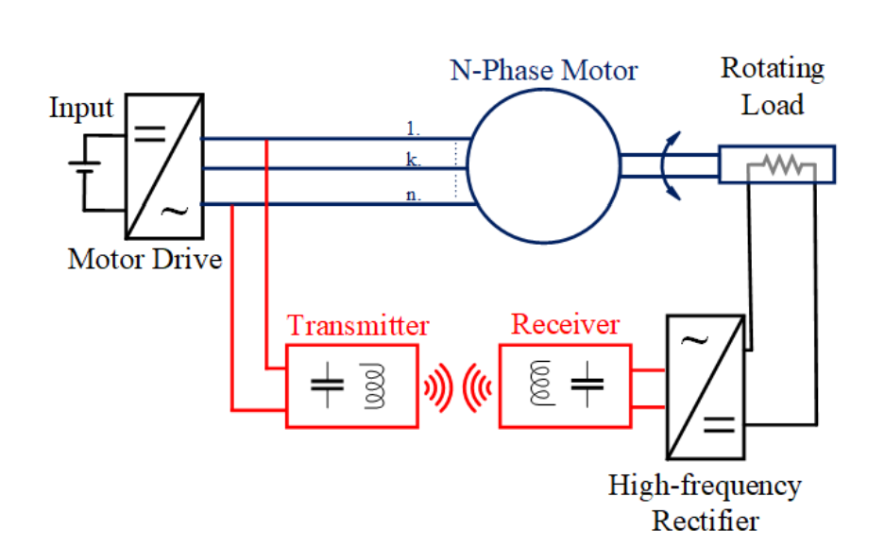
Proposed Inductive Power Transfer Based Contactless Slip Ring
The motor drive → generating high frequency
combining
The WPT system →behaves like band-pass filter
No longer required
The WPT converter → generating high frequency
Notes:
In the proposed system, the WPT system is excited by motor drive’s high frequency switching components.
Since the WPT behaves like a band-pass filter, we do not observe the low-frequency moduılating current.
Therefore, a separate WPT converter is no longer required.

Slide 7
Comparison of the Conventional and Proposed Contactless Slip Rings
 | Conventional Contactless Slip Ring | Proposed Contactless Slip Rings
Reliability | + | +*
Maintenance | + | +*
Simplicity | - | +
Speed Independency | + | +
Cost Effectivity | - | +
Efficiency | + | +
+* : a slightly advantageous
Notes:
to show our main advantes. We make a comparison table.
We increase the system reliability to elimanet extra converter, we decrease the mainatance requirements.
Also, the system is simple and cost-effective due to the eliminated converter.

Slide 8
Outline
Research Motivation
Operating Principles of Wireless Power Transfer Systems
Theory of the Proposed CSR System
Implementation of the Proposed Method with DC Motor Drives
Implementation of the Proposed Method with AC Motor Drives
Implementation of the Proposed Method for Field Excitation of SM
Conclusion

Slide 9
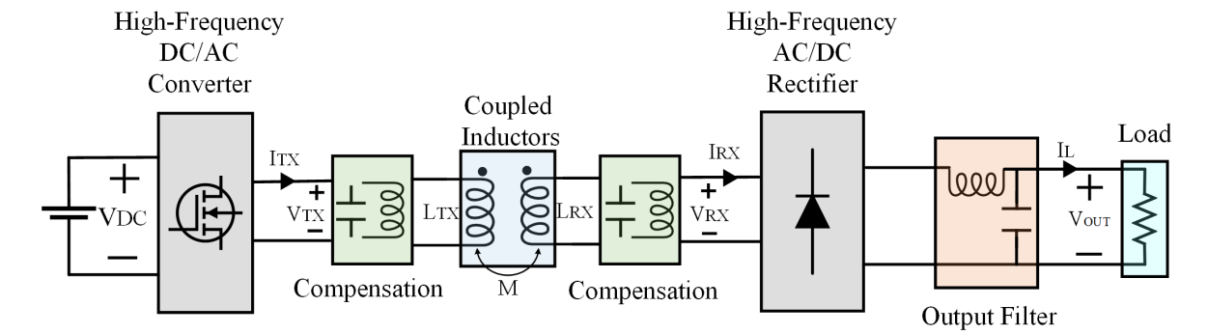
Inductive Power Transfer System
Notes:
In this figure, we have a block diagram of conventional IPT system.
We have a high-frequency converter that generates a square wave voltage/current waveform.
Without compensation, the coupled inductors have a large leakage inductance, which inherently casue a low power factor.
To compensate the leakage inductance, we can use series or parallel capaciors basically.
The capacitors and coupled inductance create a resonant structure, then only fundamental sinusoidal signal passing through the coupled coils.
The transmitted sinusoidal wave is rectified, and a ripple within DC exist.
The ripple is filtered out by the output filter, and we achieve a DC.

Slide 10
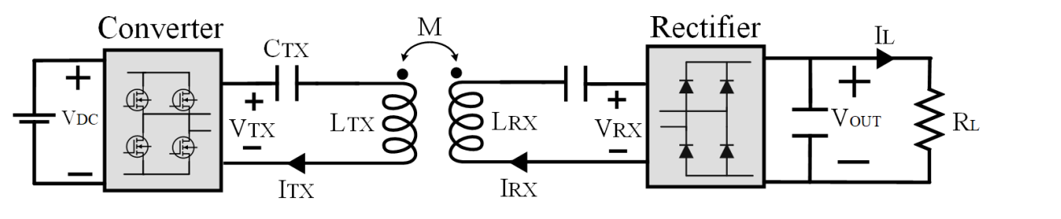
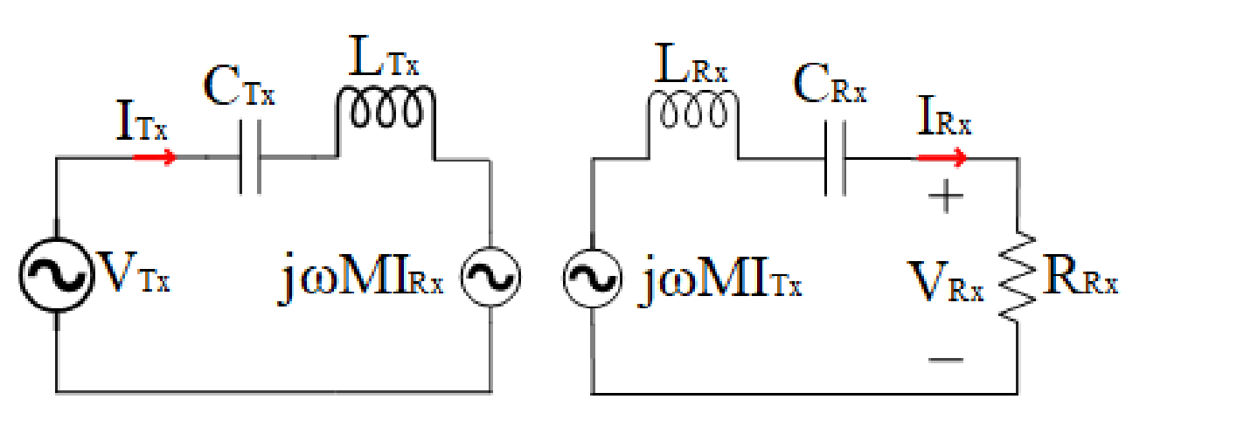
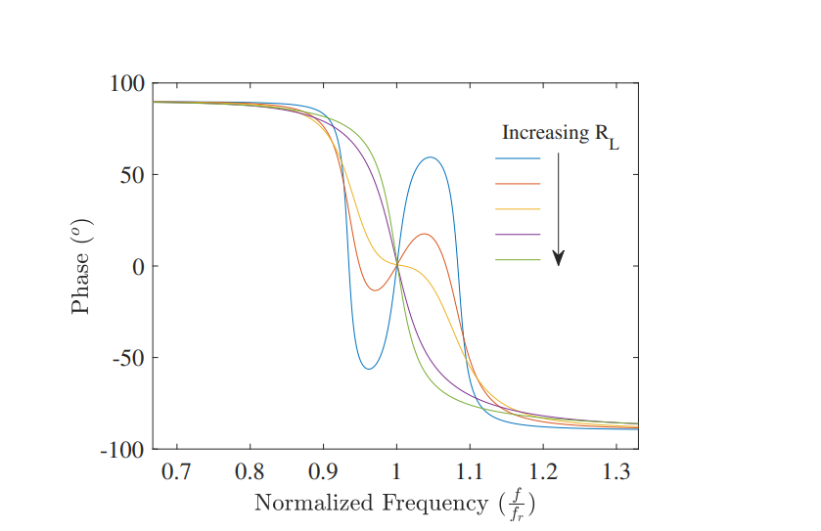
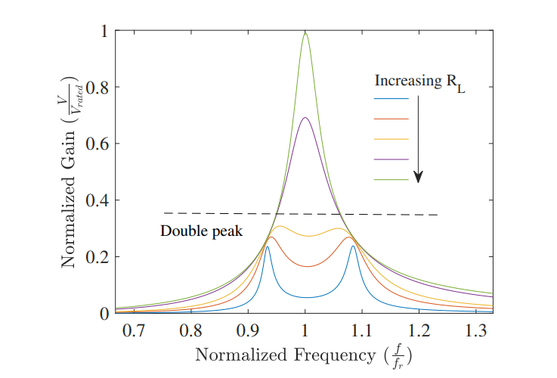
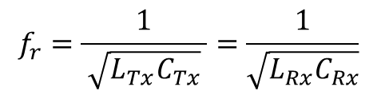
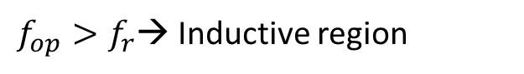
Series-Series IPT System
CRX
Single-peak band pass filter
First Harmonic Approach (FHA)
Phase < 0 → Inductive region
$f_{op}>f_{r}$→ Inductive region
$$f_{r}=\frac{1}{ \sqrt{L_{Tx}C_{Tx}} }=\frac{1}{\sqrt{L_{Rx}C_{Rx}}}$$
Notes:
In this thesis, we use series/series IPT system is preferred. Then, the secondary capacitors is removed.
We mention all in detail in thesis.
Before, we say that the IPT system behaves like band-pass filter, and only fundamental signal is transmitted. Then, to model the IPT, in frequency domain circuit diagram can be used.
For single peak band-pass filter characteristic, we have two operating region. Inductive and capacitive. If operating frequency is greater than the resonant frequency, which can be calculated like this, the system enter inductive region.
It is significant for conventional systems, to achieve ZVS. However, in our system also have motor current,

Slide 11
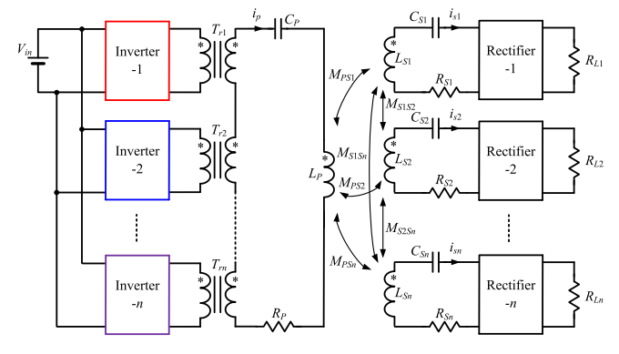
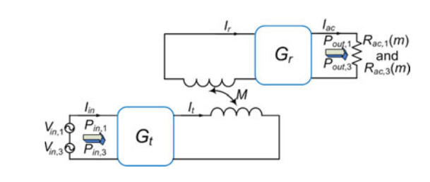
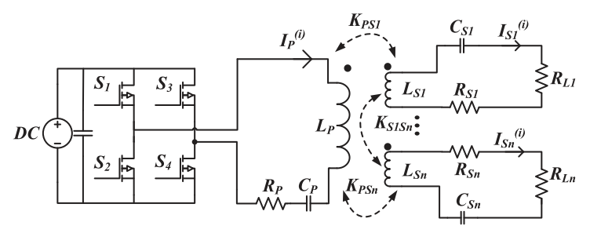
Multifrequency IPT Systems
Motivations:
To Increase power
To reduce switching components
To increase DC-link utilization rate
Operating in more than one standards
Some Topologies:
Multi-converter and multi-resonant
Single-converter and multi resonant
Single-converter and multi-load
Notes:
In conventional IPT systems, the converter generates a square wave having multiple frequencies, and only fundamental is transmitted via the resonant structure.
In literature, a multifrequency IPT systems are also utilized.
The motivations of multi-frequency can be listed as given.
For example, third harmonic of square wave is utilized via multi-resonant structure and single converter.
Or, the system can desired to operate more than frequency, multi-converter and multi-resonant can be utilized.
In our thesis, the WPT system is excited by motor drive .
It can be considered as single-converter and multi-load system, the motivation is to reduced the switching components.
However, the motor driving should be dynamic and requires fast response. Then, we should use conventional motor drive modulations.

Slide 12
Outline
Aim of Study
Inductive Power Transfer System Basics
Theory Of Theory of the Proposed System
Implementation for DC Motor
Implementation for AC Motor
Implementation for field excitation
Conclusion

Slide 13
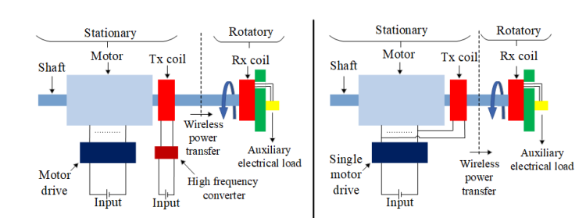
The Proposed Contactless Slip Ring Method
Conventional System
Proposed System
Motor Drives
DC motor drives
AC motor drives
Notes:
The conventional and the proposed system are presented in this figure.
The system is mounted the shaft, and Rx coil is rotating with the shaft.
We eliminate the WPT converter, and the motor drive can be AC or DC.

Slide 14
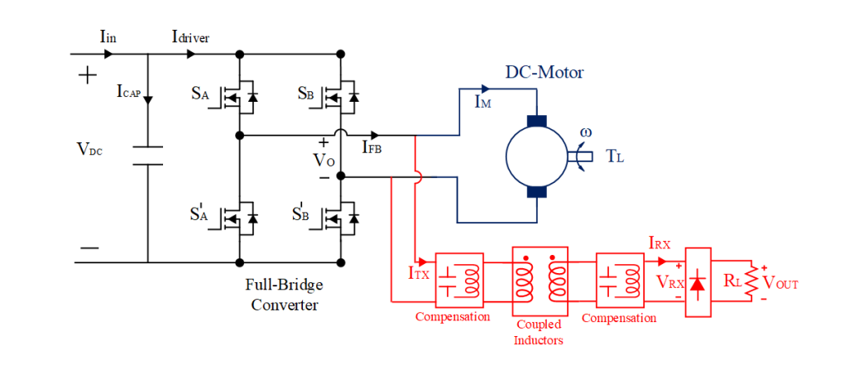
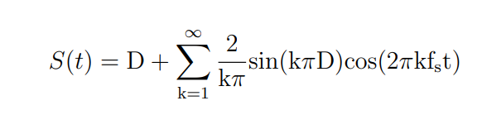
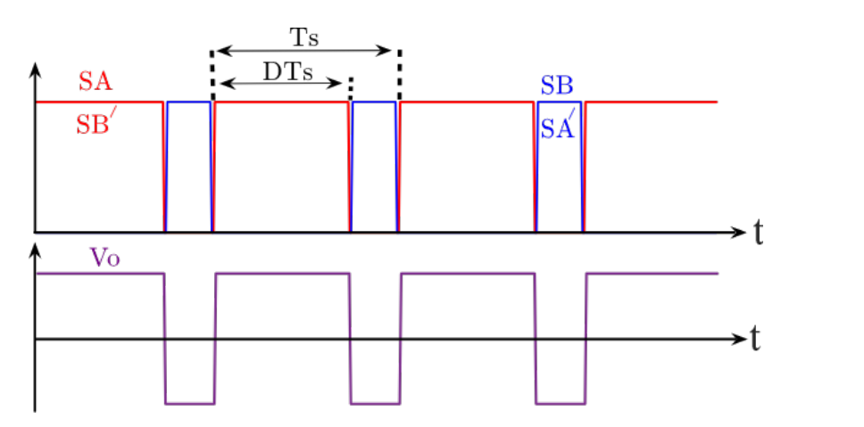
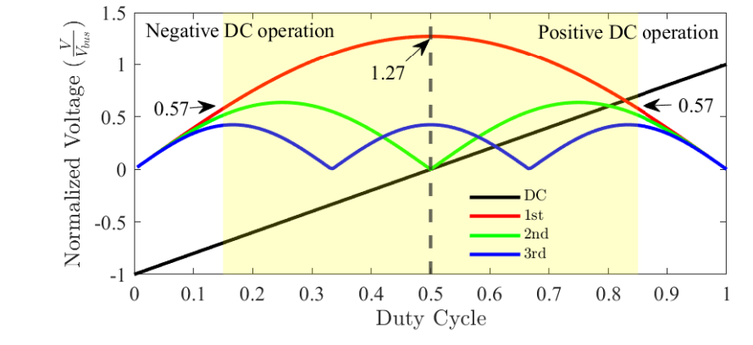

Modulation Technique for DC Motor Drives
$$S_{A}=S_{B}^{′}$$
Notes:
In DC motor drives, we use a voltage source full-bridge converter, which is commonly used since it provides four-quadrant operation. Since it is a voltage source converter, we can connect the WPT in parallel.
As a PWM method, bi-polar PWM schemes is proffered, where SA and SB’ have the same signals.
The PWM signals are shown in here, by duty cycles we change the DC voltage at the output.
According to duty cycle, the DC and swithingh harmonics are shown in here.
The duty cycle is changed to adjust the DC voltage, however switching harmınics also vary.
However, we eant to use these harmonics in WPT system, therefore the variation is challenging.
Also, we should limit our duty cycles, since the switching harmonics approaches to 0 near the duty cycle is 0 or 1.

Slide 15
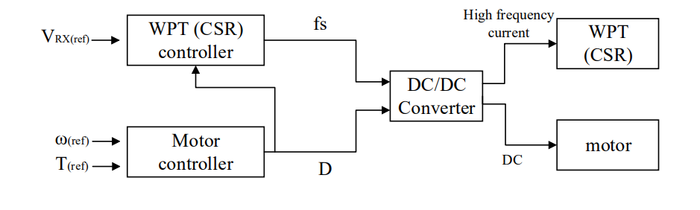
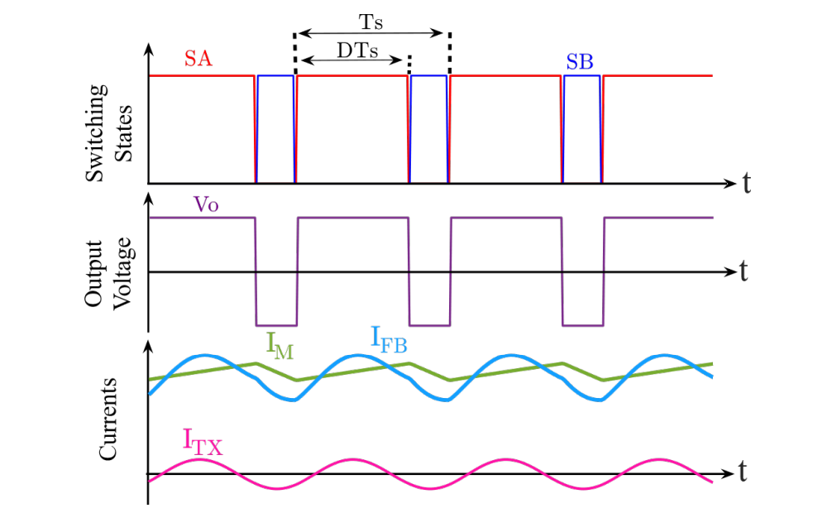
Proposed Control Method
Notes:
In the previous slide, we said that the switching harmonics varies with duty cycle.
To control WPT power, keep it constant under any modulation, we introudece a indepdent control parameter, switching freqyebct.
The gain charateristics of the WPT is shown here, we can change the gain of WPT system by switching frequency.
Switching frequency does not affect the motor operation.
By applying appropriate frequency, we keep the WPT power independent of duty cycle.
The switching signals, output voltage and current waveforms are shown here.
The WPT system is lower ratings than, the current is much smaller than the motor current. Therefore, the converter current not completely differ from the motor current.

Slide 16
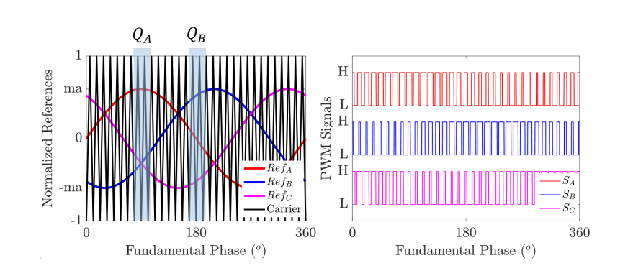
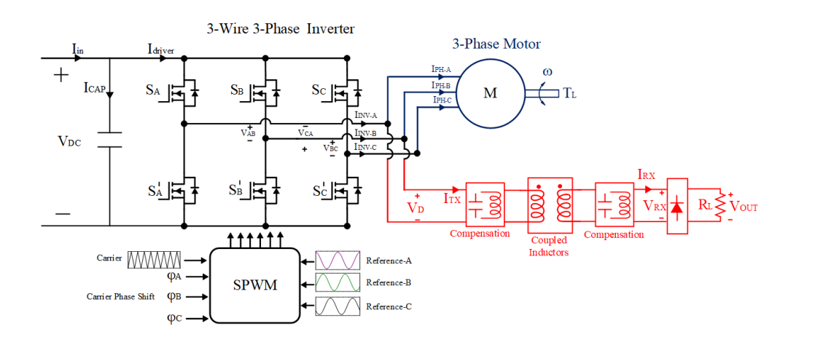
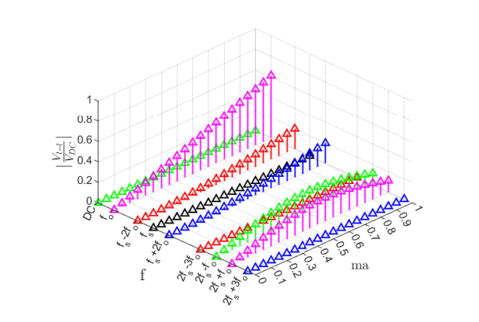
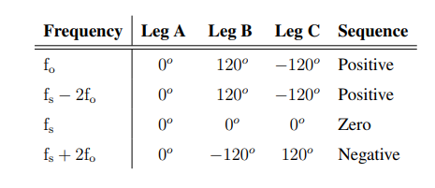
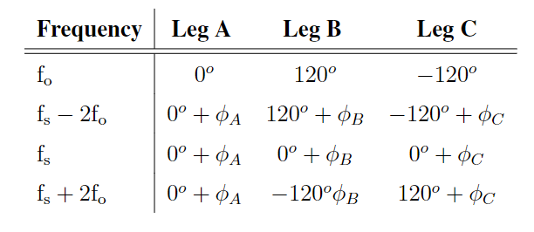
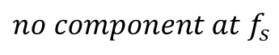
Conventional Modulation Technique
$$no component at f_{s}$$
Notes:
In AC motor drives, we use a 3-wire 3-phase voltage source inverter.
SPWM is applied to generate a required voltage waveform at the inverter output.
We have sinusoidal reference signals, and they are compared with triangular carrier signals, creating PWMs.
In standard SPWM, line-to-line voltage harmonic distribution is shown. There is no componente at the switching frequency.
Since, the switchging fdrequency and sidebands create zero/positive/ negative swquences.
In this condition, we can not control the switching harmonic, and so the WPTs power.
In the proposed system, we can give a phase shift to the carrier signals, and so we can get rid of the zero sequences.

Slide 17
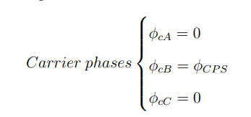
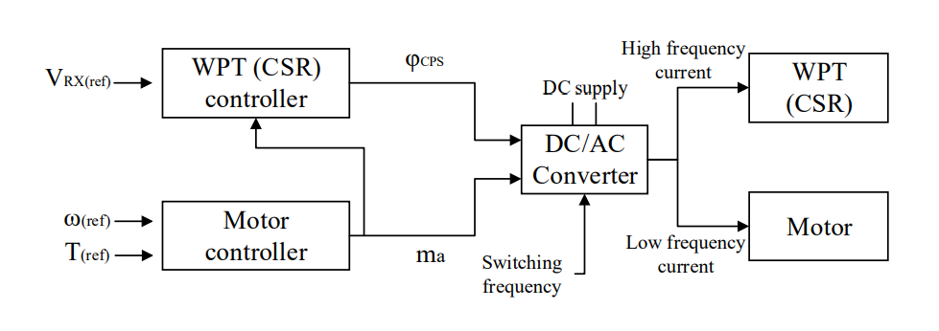
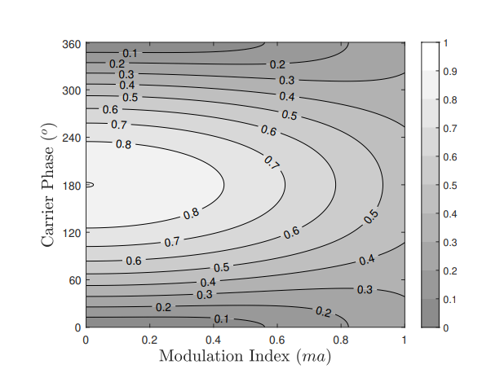
Proposed Control Method
Notes:
The WPT system is conncted to between phase-A and phase B.
By carrier phase shift to phase B, we achieve the contour.
We can oberve that we can a constant gain for any modulation.
The constant gain is between 0.25 and 0.45 over a DC-link voltage.
The control diagram is shown. According to modulation, we adjust the carrier phase-shift to control the WPTs power.

Slide 18
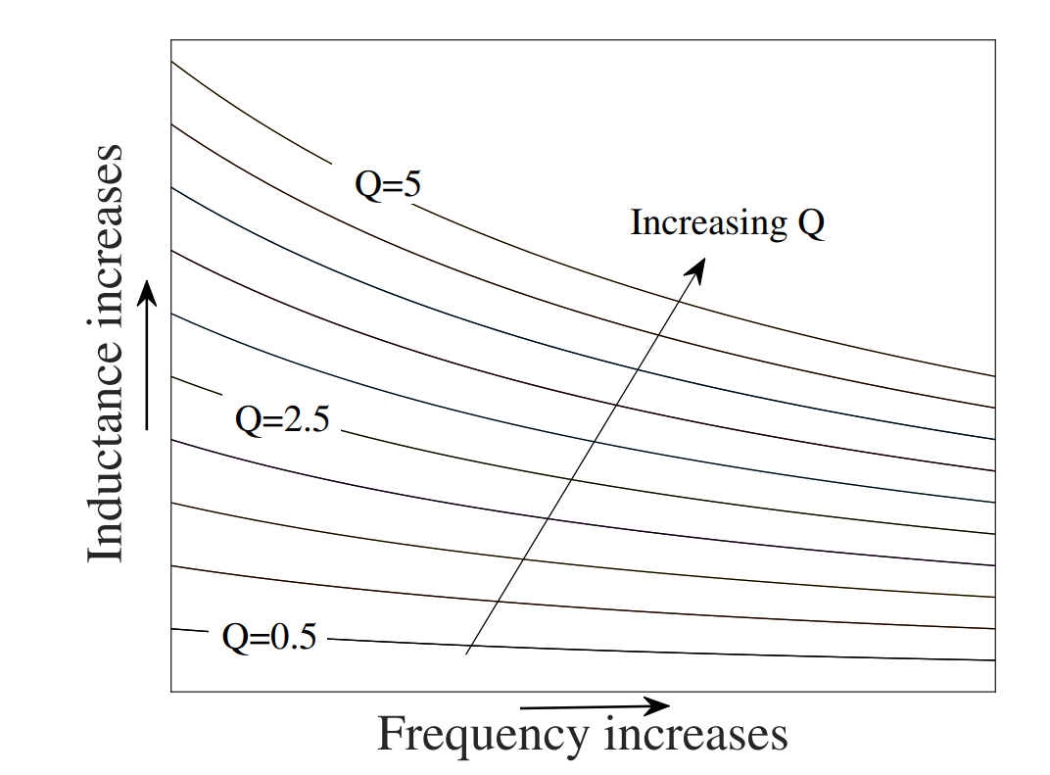
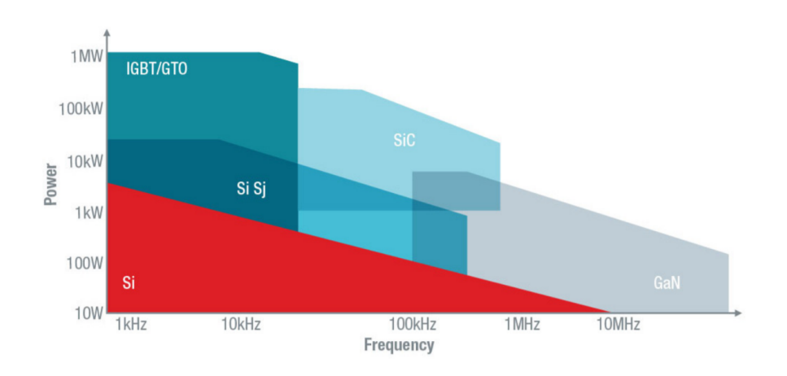
Practical Considerations
require higher switching frequency
WPT systems
to achieve smaller coil sizes
require relatively lower switching frequency
Motor
drives
to reduce
switching losses
Both requirements are provided conventional GaN or SiC based motor drives
Notes:
Until here, we discussed the concurrent operation of the WPT and motor for DC and AC motor drives.
However, some practical consideration.
The operating frequency of WPT should be higher to achieve smaller WPT coil size.
However, in conventional Si-based motor drives has lower switching frequency below 20 kHz due to the switching losses
In these range, WPT system is not feasible.
However, with the development of eideband-gap devices, the siwthing frequency increases up to 100 kHz.
Therefore, the proposed system is suitable to apply motor drives based on SiC and GaN semiconductors.

Slide 19
Outline
Research Motivation
Operating Principles of Wireless Power Transfer Systems
Theory of the Proposed CSR System
Implementation of the Proposed Method with DC Motor Drives
Implementation of the Proposed Method with AC Motor Drives
Implementation of the Proposed Method for Field Excitation of SM
Conclusion

Slide 20
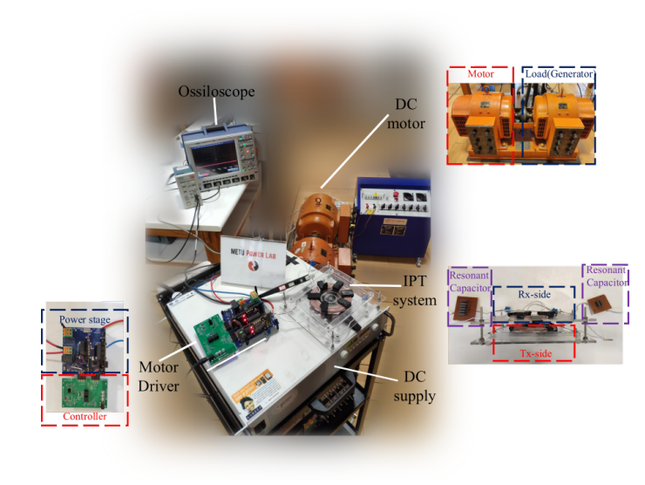
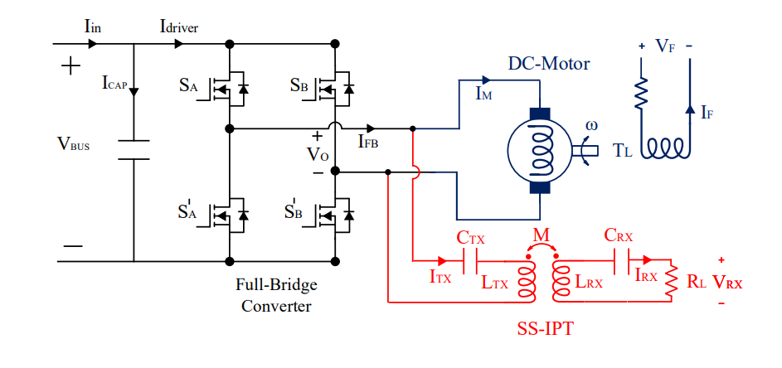
System Overview and Experimental Setup
Notes:
We have a full-bridge converter and separately excited DC motor.
The SS-IPT system is connected in parallel to motor drive.
The experimental setup is shown in figure.

Slide 21
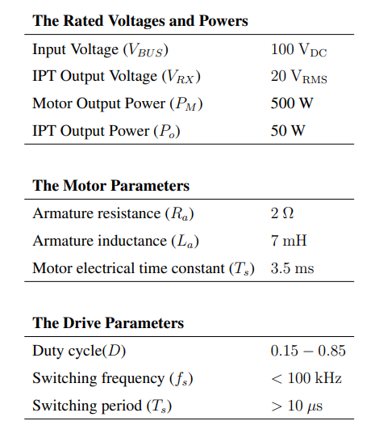
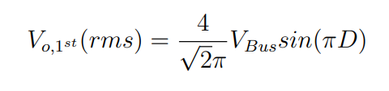
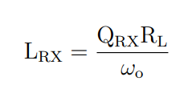
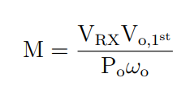
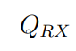
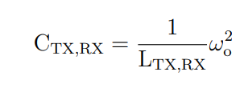
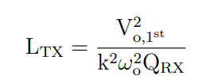
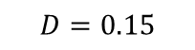


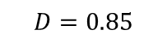
Wireless Power Transfer System Design Procedure
$$0.15 < D< 0.85$$
$40 V_{RMS}$< $V_{o,1^{st}}(rms)$< $90 V_{RMS}$
$$D=0.15$$
$$D=0.5$$
$$D=0.85$$
$$k$$
Notes:
The system ratings are presented here.
Before the design stage of WPT system, the DC-link voltage and duty cycle limits are important.
The duty cycle is limited between 0.15 and 0.85, which means that minimum voltage at the switching frequency is 40V.
The maximum voltage Is reached at D=0.5, which give 90V.
Therefore, the WPT system should give the desired power for these input variation, which is actually compensated by frequency control.
Coupling, quality factor are design parameters, which are selected in reasonable range discussed in the literature.

Slide 22
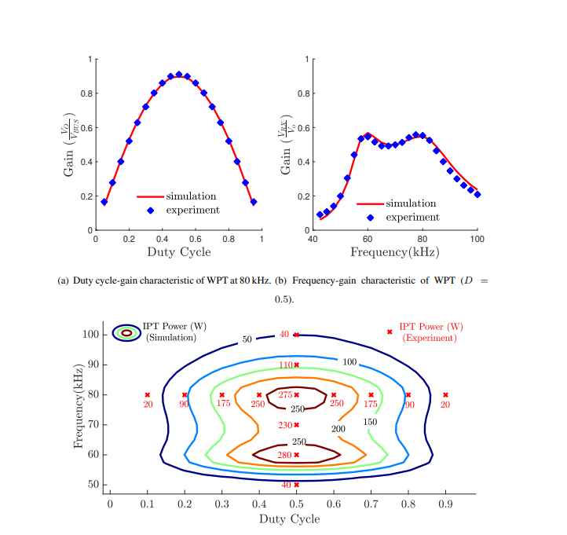
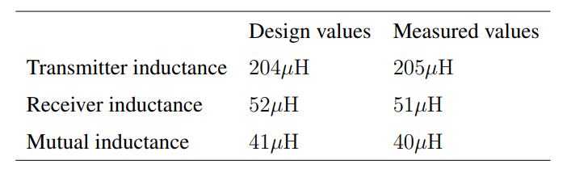
Experimental Results- WPT System Validation
Notes:
The design and measured values are presenred here.
The WPT system is tested for different duty cycle and switching frequency.
The contour of the power over duty cycle and switching frequency is plotted .
We can observe iso-power lines. We choose the outer iso-power line, which can supply the desired power under given duty cycle.

Slide 23
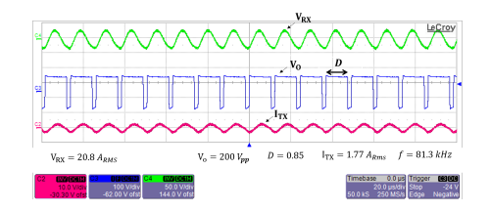
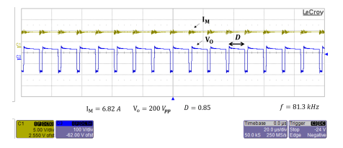
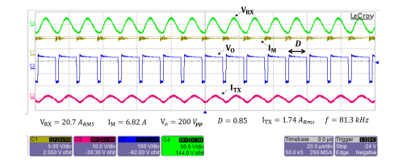
Experimental Results - Concurrent Operation
Notes:
In order to validate the concurrent operation.
Firstly, only the WPT system is connected. Switching frequency is 81.3 kHz and duty cycle is 0.85, and its output voltage is 20.8V.
Then, for the same duty cycle and switching frequency, only motor is connected to drive. Motor drive delivers 480W.
After, the WPT and motor are connected together.
It is observed that the motor and WPT is provided the power as the same as stand-alone connection.
Therefore, we can say that the concurrent operation can be done by applying appropriate duty cycle and switching frequency.
In the thesis, the concurrent operation is tested under several dutyc cycles and switching frequency to observe the continuous power transfer.

Slide 24
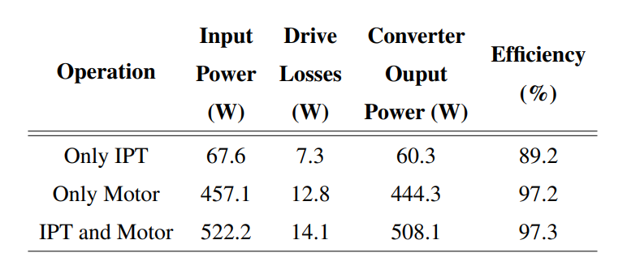
Experimental Results – Loss and Efficiency
Notes:
Okey, we acheieve concurrent operation, but it can increase the losses , and the system cannot be face with the thermal stress.
The drive losses are measured via a calorimeter setup.
The drive losses of concurrent operation increase only 10% compared to the only motor operation.
Even the sum of only IPT and only motor losses is much bigger than the concurrent operation.
The Ipt current is much less than the motor current, then there is a small increment on the only motor operation.

Slide 25

Experimental Results – Transient Load Changes
Notes:
Another test is about transient load changes.
The motor and WPT have varying load conditions.
Although the duty cycle and frequency does not change, the load change can affect the each other operation.
The transient load changes do not affect the steady-state operation of the motor and WPT system.
However, it was observed that the motor is affected transitory where the current slightly changes ( by a 5% overshoot or undershoot ).
Then, it reaches the expected steady-state value in a short time as expected
These tests prove the independent and concurrent operation of the motor and WPT system.

Slide 26
Outline
Research Motivation
Operating Principles of Wireless Power Transfer Systems
Theory of the Proposed CSR System
Implementation of the Proposed Method with DC Motor Drives
Implementation of the Proposed Method with AC Motor Drives
Implementation of the Proposed Method for Field Excitation of SM
Conclusion

Slide 27



System Overview and Experimental Setup
Notes:
We have a 3-phase 3- wire inverter and induction machine
The SS-IPT system is connected to two-legs of the inverter in parallel to motor
The experimental setup is shown in figure.
The system ratings also given. As discussed before, the gain can be constant by carrier phase shift. Therefore, the carrier phase-shift is adjusted between 30 and 60 degree to achieve 0.3 gain.

Slide 28


Experimental Results- Carrier Phase Shift Validation
Notes:
Firstly, the SPWM and carrier-phase shift is validated.
With and withut CPS, inverter output voltage at the fundamental, switching and its sidebands are mathematically calculated.
After that, the ouyptut voltage şs measured and harmonic distribution is in goog aggrement with therotical calculation.

Slide 29

Experimental Results - Concurrent Operation
Notes:
In order to validate the concurrent operation.
Firstly, only the motor is connected. Modulation is 0.8 and carrier phase shift is 40 degree.
The motor draws 1.75 A.
Then, for the same modulation and carrier phase shift, the WPT is connected to motor drive.
It draws 0.35 A.
After, the WPT and motor are connected together.
It is observed that the motor and WPT is provided the currents as the same as stand-alone connection.
Therefore, we can say that the concurrent operation can be done by applying appropriate modulation and carrier phase shift.

Slide 30


Experimental Results – Variable Carrier Phase Shify
Notes:
Another tests are made to find the required carrier phase shifts to achieve constant power.
A look-up table is obtained in experimental setup, and the carrier phase shift values are compared with therotical ones.
They are in good aggrement.
Besides, as can be seen in figure, with appropriate carrier phase shift, the power is kept constant.

Slide 31


Experimental Results – Transient Load Changes

Slide 32
Outline
Research Motivation
Operating Principles of Wireless Power Transfer Systems
Theory of the Proposed CSR System
Implementation of the Proposed Method with DC Motor Drives
Implementation of the Proposed Method with AC Motor Drives
Implementation of the Proposed Method for Field Excitation of SM
Conclusion

Slide 33



System Overview and Experimental Setup
Notes:
We have a 3-phase 3- wire inverter and synchronous machine.
Here, we use a SN-IPT system, connected to two-legs of the inverter in parallel to motor
The experimental setup is shown in figure.
The system ratings also given. As discussed before, the gain can be constant by carrier phase shift.
In order to decrease the Tx current, we choose the maximum controlable voltage gain over every modulation index is selected. It is 0.40.
The design of SN IPT system and explained in details in the thesis, we pass the experimental results directly.

Slide 34


Experimental Validation- Carrier Phase Shift
Notes:
The field of the synchoronous is fed by the WPT system.
We have 3 operation condition of different modulation indexes.
The proposed carrier phase shift guarentees the mean value of the field current is brought the desired value.
However, we observe that increasing modulation index causes a low-frequency fluctuation, which have double fundamental frequency.
The current fluctuations are presented in this figure.
The fluctuation is stemmed from the sideband harmonics, which changes the effective voltage magnitude at the switching frequency compenent.
The fluctuation should be mitigated since it can cause a torque and speed ripple fot the synchronous machine.

Slide 35



New real-time algorithm
Notes:
So, a new idea is revealing here.
Real-time control of the switching frequency to keep the magnitude constant.
In each operation point, over a fundamental frequency, the switching component magnitudes changes.
Therefore, for each switching interval, we can calculate the carrier phase shift value before appliyinh the PWMs.
And we achieve a constant magnitude at the WPT.
The carrier phase shift can be calculated by fourier series and phasor domain sum, as can be seen these equations.

Slide 36




New real-time algorithm
$${\hat{S}}_{AB_{fs}}=0.43 !$$
Notes:
However, in these conditions, also we have some restrictions.
Since the duty cycle at any time is dependent the motor modulation, so SPWM,
We cannot achieve some voltages.
In these figures, we draws the maximum and minimum voltage gains for several modulation index.
Maximum voltages is actually correspond to 180 degree carrier phase shift while minimum voltage is correspond to 0 degree.
As can be observed graphically, we can achieve 0.43 gain over a fundamental frequency for every modulation index below 0.85.
to avoid low-frequency fluctuation, we can restricts our modulation index.

Slide 37


Experimental Validation- Carrier Phase Shift
Notes:
After that, we repeat the same experiment with previous ones.
The field current, however, is a little bit different since the voltage restriction. It give 30 V rms while before we use 45 V rms.
The low-frequency fluctuations still exist, but, the magnitude is considerably reduced.
It is almost in quart of previous test for modulation index is 0.5.

Slide 38
Outline
Research Motivation
Operating Principles of Wireless Power Transfer Systems
Theory of the Proposed CSR System
Implementation of the Proposed Method with DC Motor Drives
Implementation of the Proposed Method with AC Motor Drives
Implementation of the Proposed Method for Field Excitation of SM
Conclusion
Notes:
In this thesis, a novel, cost-effective and simple-to-implemnnt contactless slip ring system is proposed.
The system can be applied in DC or AC motor drives, and the proposed system does not require any active converter.
The proposed system can be established by using conventional PWM schemes.
Firstly, we continue with the literature review.

Slide 39

Performance Comparisons
Notes:
The performance comparison of the proposed system and conventional couneterparts are given.
Although the system is based on inductibe couplers, capacitive couplers can be used.
The proposed system decreases the number of regular maintenance.
They do transfer energy independent of speed.
The scalability of the proposed system is difficult. Since the proposed system, the WPT power is lower ratings than the motor drive. Therefore, increasing power is difficult.
Conventional inductive or cpaacitve coupler requires external AC source, which is provided via external active converter.
However, in the proposed system, we use directly motor drive output.

Slide 40


Performance Comparisons
Notes:
Several contactless slip ring works exsit in the literature.
CPTs are suitable to transfer power with higher frequency, and medium 108 power requirements over an even shorter airgap
IPTs can be used in a broad range of air power ratings.
So, we have wide range of frequency, power airgap and size regarding applications.
However, all of this have extra high-frequency power converter.
Also, several multi-frequency studies for WPT systems exist.
The proposed system use conventional motor driving modulation techniques, and uses the switching frequency.
Offline algorithm does not requires and switching losses decreases.

Slide 41
Contributions
A cost-efficient and simple-to-implement contactless slip ring is introduced.
For DC motor drives, a multi-frequency approach is presented to implement with a conventional DC motor PWM technique.
An independent control scheme, which comprises frequency and duty cycle control, is proposed for concurrent DC and high-frequency AC power transfer to the motor and rotating loads, respectively.
For AC motor drives, a multi-frequency approach is presented to implement with a conventional AC motor PWM technique.
An independent control scheme, which comprises carrier phase shift and modulation index control, is proposed for concurrent low-frequency AC and high frequency AC power transfer to the motor and slip rings, respectively.
For field excitation of the synchronous motors, a brushless slip ring is proposed to directly integrate into the motor drive with light-weight on the rotating side.
A novel real-time carrier-phase-shift calculation algorithm embedded in the motor control loop is developed to avoid low-frequency ripples stemming from the sideband harmonics.
Notes:
The main contributions are listed here.

Slide 42
Future Works
Improved coil design.
Capacitorless (Light-weight rotating side) WPT topologies.
Multi-phase WPT system.
Closed loop control, and current estimation algorithms.
Notes:
Finally, we have some future works.
In this study, we were not interested in coil design. An optimum coil design minimize loss and size can be achieved.
We use SS and SN WPT systems, and they requires a capacitive filters. Like SP WPT systems, several topologies requires inductrive filtering, which is more sutiable to our problem.
In AC machines, we use two wires of 3-wire. It cca cause a thermal unequlity and unbalance.
We can use three phase windings to achieve another output voltages or increase power capability.
We can improve our analytical modelling, adding some parasiticis like dead time or we can make out cacluation in time domain.
Finally, we do not

Slide 43
Thanks!

Slide 44

Wireless Power Transfer Based Contactless Slip Rings
 | Inductive Power Transfer | Capacitive Power Transfer
Transfer Type | Varying MF | Varying EF
Power Ratings | High | Low
Frequencies | Low | High
Efficiency | High | High
Distance | Moderate | Low
Tesla’s WPT System

Slide 45

Inductive Power Transfer
DC/AC converter
Compensation Circuits
Transmitter/Receiver Coils
AC/DC Rectifiers

Slide 46

Compensation Topologies
Series-Series Compensation
Source Type | Voltage Source
Resonant frequency | Load Independent
Resonant frequency | Coupling Independent
No load operation | Short Circuit
Capacitor Size | Large
a) Series-series
b) Parallel-series
c) Series-parallel
d) Parallel-parallel

Slide 47


Zero Voltage Switching
Inductive region → The capacitance of the switches discharges by the load current during dead time.

Slide 48




Bifurcation Phenomenon
Double-peak
$f_{op}>f_{r}$→ Inductive region
Making control difficult
Decreasing efficiency

Slide 49





DC Motor Drives
Varying
armature voltage
Constant field
excitation
$$E_{a}=K_{A}ω$$
T$=K_{A}I_{A}$
Control diagram

Slide 50




AC Motor Drives
Induction motor
Synchronous motor
Varying armature voltage and frequency

Slide 51

Conventional Modulation Technique

Slide 52

Proposed Modulation Technique

Slide 53




Proposed Modulation Technique

Slide 54


Wireless Power Transfer System Design

Slide 55


Coil Design

Slide 56



Impedance Modelling and Control

Slide 57

Experimental Results – Different Operating Conditions

Slide 58









Wireless Power Transfer System Design

Slide 59


Wireless Power Transfer System Design

Slide 60







Wireless Power Transfer System Design

Slide 61

New real-time algorithm

Slide 62
Proposed Control Method

